Slide 1
Big Data Ecosystem Technical Deep Dive – Day4
Sashank Pappu
Azure Data & AI Specialist
Shiva Priya
Azure Data Engineer

Slide 2
What shall we learn today ?
Azure Data Bricks Understanding & Scalability
Azure Data Bricks & Data Factory Integration
Data Bricks Delta
Data Lake Integration with Data Bricks
Snow Flake with Data Bricks
Streaming Data using Event Hubs & Data Bricks

Slide 3
More Detailed Agenda
9-10 AM : Understanding on Databricks
10-11:30 : Data Factory & Databricks
11:30-11:45 : BREAK !!!
11:45-1PM : Databricks Delta
1-2PM : LUNCH
2-2:30 : Delta Part 2
2:30-3PM : Snow Flake with Databricks
3-3:15 : BREAK!!!
3:15-5 : Streaming with Databricks

Slide 4







Distributed storage PaaS on Azure
Errr…. What are all these? Why so many? When do I use these? Wait, now you have this new thing called *Delta*? I am dizzy and ready to pass out!
MPP database
Object store
No-SQL
Azure Data Lake Store
Azure Blob Storage
Azure Cosmos DB SQL API Cassandra API MongoDB API
Azure SQL Datawarehouse
Azure HDInsight-HBase
Notes:
Azure Databricks Delta was in private preview for a while, we announced public preview last month and has been running production workloads for a while.
As discussed earlier, Azure Databricks extends Apache Spark environment and comes with additional benefit such as – collaborative workspace environment, security features such as role based access control, cloud optimized with capabilities such as autoscale.
Delta focused on 2 important areas that still remain a challenge
Data reliability
Faster analytics
These are 2 core benefits that you get with Delta as we go through the rest of slide

Slide 5
Scalable OLTP, IoT store, time series database Fit for purpose
MPP database
No-SQL
Object store
Azure Cosmos DB SQL API Cassandra API MongoDB API
Azure HDInsight-HBase
Azure SQL Datawarehouse
Optimized for low latency - point reads, random CRUD, small range queries/scans, transaction guarantees
Azure Data Lake Store
Azure Blob Storage
Notes:
Azure Databricks Delta was in private preview for a while, we announced public preview last month and has been running production workloads for a while.
As discussed earlier, Azure Databricks extends Apache Spark environment and comes with additional benefit such as – collaborative workspace environment, security features such as role based access control, cloud optimized with capabilities such as autoscale.
Delta focused on 2 important areas that still remain a challenge
Data reliability
Faster analytics
These are 2 core benefits that you get with Delta as we go through the rest of slide

Slide 6
Datawarehousing Fit for purpose
MPP database
No-SQL
Azure SQL Datawarehouse
Object store
Azure Cosmos DB SQL API Cassandra API MongoDB API
Azure HDInsight-HBase
Optimized for parallel processing of structured data with T-SQL, server side programmability, in-memory processing and massive scale. Complement with an RDBMS based reporting mart for supporting direct query for BI – for concurrency beyond Azure SQL Data warehouse concurrency limits. Alternately complement with Azure Analysis Services (AAS) for BI
Azure Data Lake Store
Azure Blob Storage
Notes:
Azure Databricks Delta was in private preview for a while, we announced public preview last month and has been running production workloads for a while.
As discussed earlier, Azure Databricks extends Apache Spark environment and comes with additional benefit such as – collaborative workspace environment, security features such as role based access control, cloud optimized with capabilities such as autoscale.
Delta focused on 2 important areas that still remain a challenge
Data reliability
Faster analytics
These are 2 core benefits that you get with Delta as we go through the rest of slide

Slide 7
Data Lake Fit for purpose
MPP database
No-SQL
Optimized for structured and unstructured data storage, massively scalable; RBAC.
Object store
Azure Cosmos DB SQL API Cassandra API MongoDB API
Azure HDInsight-HBase
Azure SQL Datawarehouse
Azure Data Lake Store
Azure Blob Storage
Notes:
Azure Databricks Delta was in private preview for a while, we announced public preview last month and has been running production workloads for a while.
As discussed earlier, Azure Databricks extends Apache Spark environment and comes with additional benefit such as – collaborative workspace environment, security features such as role based access control, cloud optimized with capabilities such as autoscale.
Delta focused on 2 important areas that still remain a challenge
Data reliability
Faster analytics
These are 2 core benefits that you get with Delta as we go through the rest of slide

Slide 8

Analytics store – structured, unstructured Fit for purpose
Optimized for large sequential scans, structured, unstructured data - typical for data engineering pipelines and data prep for machine learning at scale, and model training. No random update, delete capability; No transaction guarantees; Not optimized for small files generated from streaming workloads. Not optimized for BI direct access.
MPP database
No-SQL
Object store
Azure Cosmos DB SQL API Cassandra API MongoDB API
Azure HDInsight-HBase
Azure SQL Datawarehouse
Databricks Delta
Azure Data Lake Store
Azure Blob Storage
Optimization on top of object storage for batch and real-time analytics
Notes:
Azure Databricks Delta was in private preview for a while, we announced public preview last month and has been running production workloads for a while.
As discussed earlier, Azure Databricks extends Apache Spark environment and comes with additional benefit such as – collaborative workspace environment, security features such as role based access control, cloud optimized with capabilities such as autoscale.
Delta focused on 2 important areas that still remain a challenge
Data reliability
Faster analytics
These are 2 core benefits that you get with Delta as we go through the rest of slide

Slide 9



Reporting & BI Fit for purpose
PowerBI
Azure Analysis Services
No-SQL
MPP database
Pipe to reporting mart RDBMS
Azure SQL Database
Azure SQL Datawarehouse
Pipe to reporting mart/Warehouse
Azure Cosmos DB SQL API Cassandra API MongoDB API
Azure HDInsight-HBase
Azure SQL Datawarehouse
Object store
Azure Data Lake Store
Azure Blob Storage
Notes:
Azure Databricks Delta was in private preview for a while, we announced public preview last month and has been running production workloads for a while.
As discussed earlier, Azure Databricks extends Apache Spark environment and comes with additional benefit such as – collaborative workspace environment, security features such as role based access control, cloud optimized with capabilities such as autoscale.
Delta focused on 2 important areas that still remain a challenge
Data reliability
Faster analytics
These are 2 core benefits that you get with Delta as we go through the rest of slide

Slide 10
Real-time analytics – persistence and serve layer Fit for purpose
MPP database
No-SQL
Not as optimized for either real time performant ingest or for serving, but supports sinking from stream processing pipelines in an append mode with some nuances.
Object store
Azure Cosmos DB SQL API Cassandra API MongoDB API
Azure HDInsight-HBase
Azure SQL Datawarehouse
Azure Data Lake Store
Azure Blob Storage
Notes:
Azure Databricks Delta was in private preview for a while, we announced public preview last month and has been running production workloads for a while.
As discussed earlier, Azure Databricks extends Apache Spark environment and comes with additional benefit such as – collaborative workspace environment, security features such as role based access control, cloud optimized with capabilities such as autoscale.
Delta focused on 2 important areas that still remain a challenge
Data reliability
Faster analytics
These are 2 core benefits that you get with Delta as we go through the rest of slide

Slide 11
Analytics store Nuances and data engineering challenges

Slide 12
Data engineering challenges with analytics storage Batch and streaming analytics focus
# | CHALLENGE | WORKAROUND WITH CODE
1 | No ACID support | Get creative
2 | No support for random update/upsert | Batch job Read entire original dataset minus to row be updated, Union with updated row, Overwrite original dataset with above
3 | No support for random delete | Batch job Read entire original dataset minus to row be deleted, Overwrite original dataset with above
4 | Streaming jobs generate very small files not optimized for Spark | Batch job Runs a Spark process that periodically concatenates small files into large files, ensure you don’t disrupt processing in progress
5 | Streaming jobs can constantly add partitions and/or files and render the metastore entry for the dataset stale, resulting in partial data returned to the client when queried; Metadata updates add latency; | Run the following before querying: alter table add partition OR msck repair table AND analyze table compute statistics
6 | Standard tables do not allow combining streaming and batch for best latencies – no unified solution | Get creative
More……….

Slide 13
Data engineering challenges with analytics storage Batch and streaming analytics focus
# | CHALLENGE
7 | Schema changes can add further complexity
8 | Going back in time and updating data - painful
9 | No indexing support to speed performance
10 | Schema changes can break enrichment, joins, transforms between stages
11 | Concurrent access suffer from inconsistent query results
12 | Failing streaming jobs can require resetting and restarting data processing
13 | Failures may cause data between stages to either drop on the floor or be duplicated
14 | Multi-dimensional queries are a challenge
More……….

Slide 14
What is Databricks Delta?

Slide 15

Databricks Delta is fundamentally…..
Azure Databricks
Delta storage format
+ more
Object store
Azure Data Lake Store
Azure Blob Storage
Notes:
Azure Databricks Delta was in private preview for a while, we announced public preview last month and has been running production workloads for a while.
As discussed earlier, Azure Databricks extends Apache Spark environment and comes with additional benefit such as – collaborative workspace environment, security features such as role based access control, cloud optimized with capabilities such as autoscale.
Delta focused on 2 important areas that still remain a challenge
Data reliability
Faster analytics
These are 2 core benefits that you get with Delta as we go through the rest of slide

Slide 16



Promise of Databricks Delta
Spark on Databricks, storage format optimization for
faster analytics,
better data reliability guarantees,
and simplified data pipelines
Data Reliability
+
Faster Analytics
Notes:
Azure Databricks Delta was in private preview for a while, we announced public preview last month and has been running production workloads for a while.
As discussed earlier, Azure Databricks extends Apache Spark environment and comes with additional benefit such as – collaborative workspace environment, security features such as role based access control, cloud optimized with capabilities such as autoscale.
Delta focused on 2 important areas that still remain a challenge
Data reliability
Faster analytics
These are 2 core benefits that you get with Delta as we go through the rest of slide

Slide 17
Era Of Big Data
How it evolved and what is is for us in current market trends

Slide 18
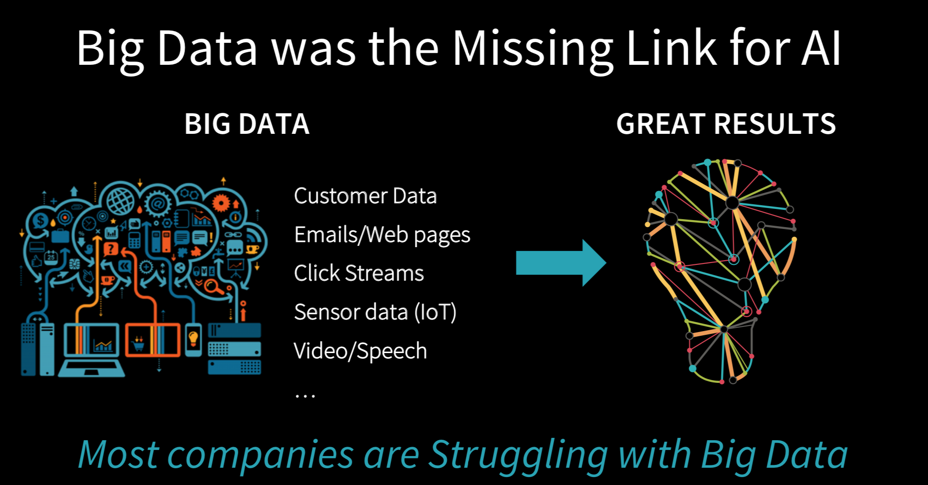

Slide 19
BigData is not only Hadoop

Slide 20
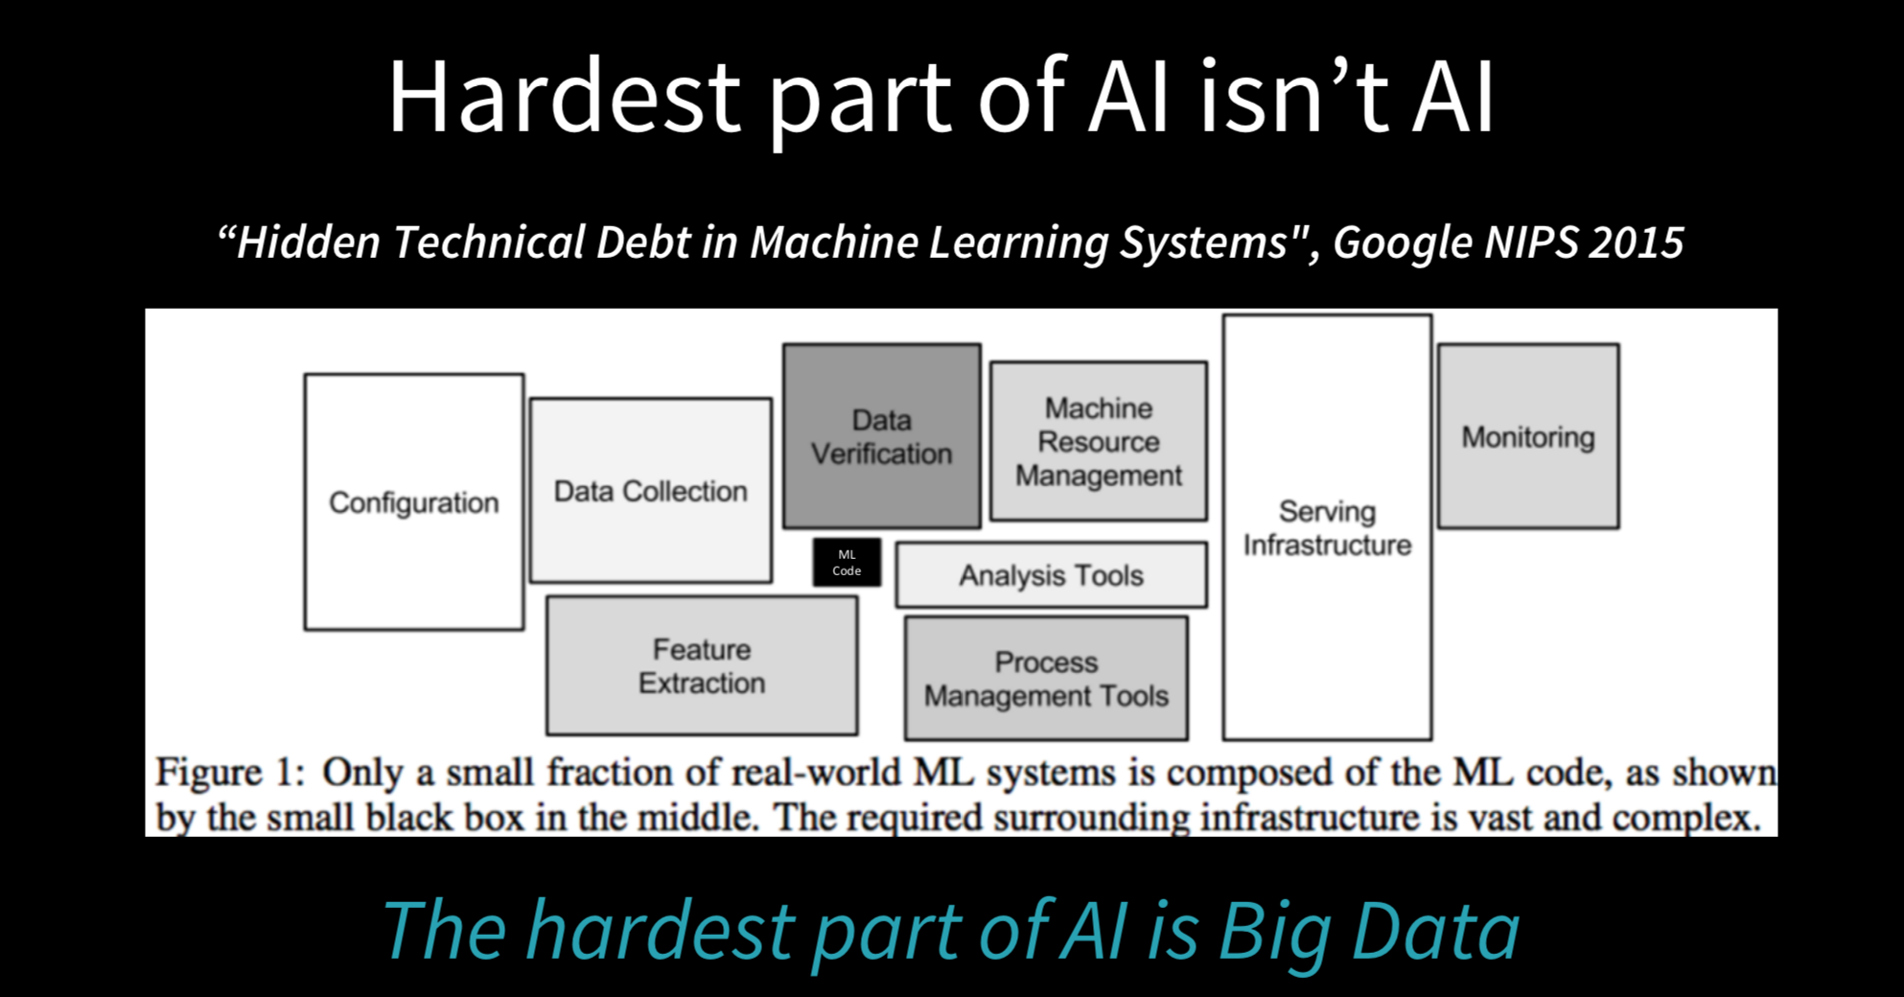

Slide 21
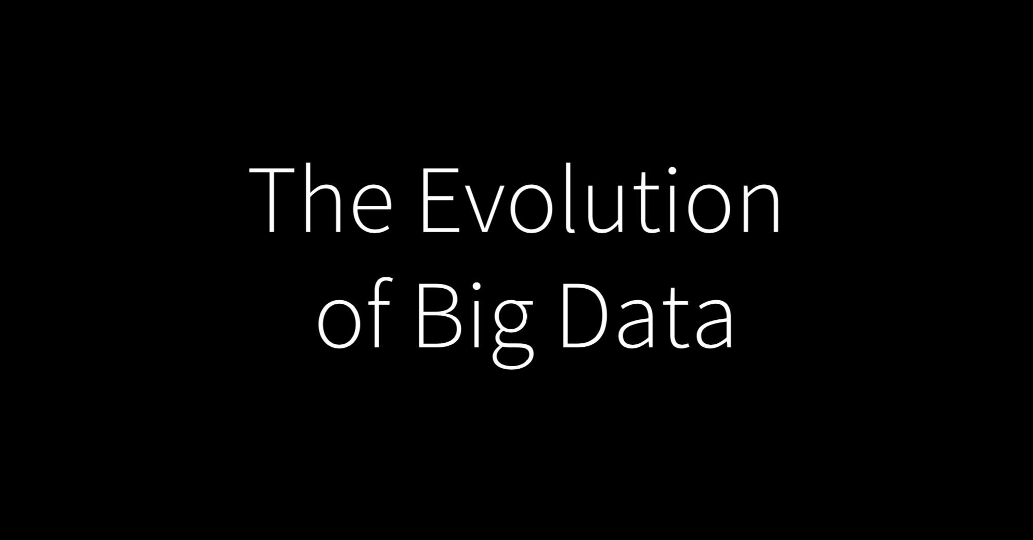

Slide 22
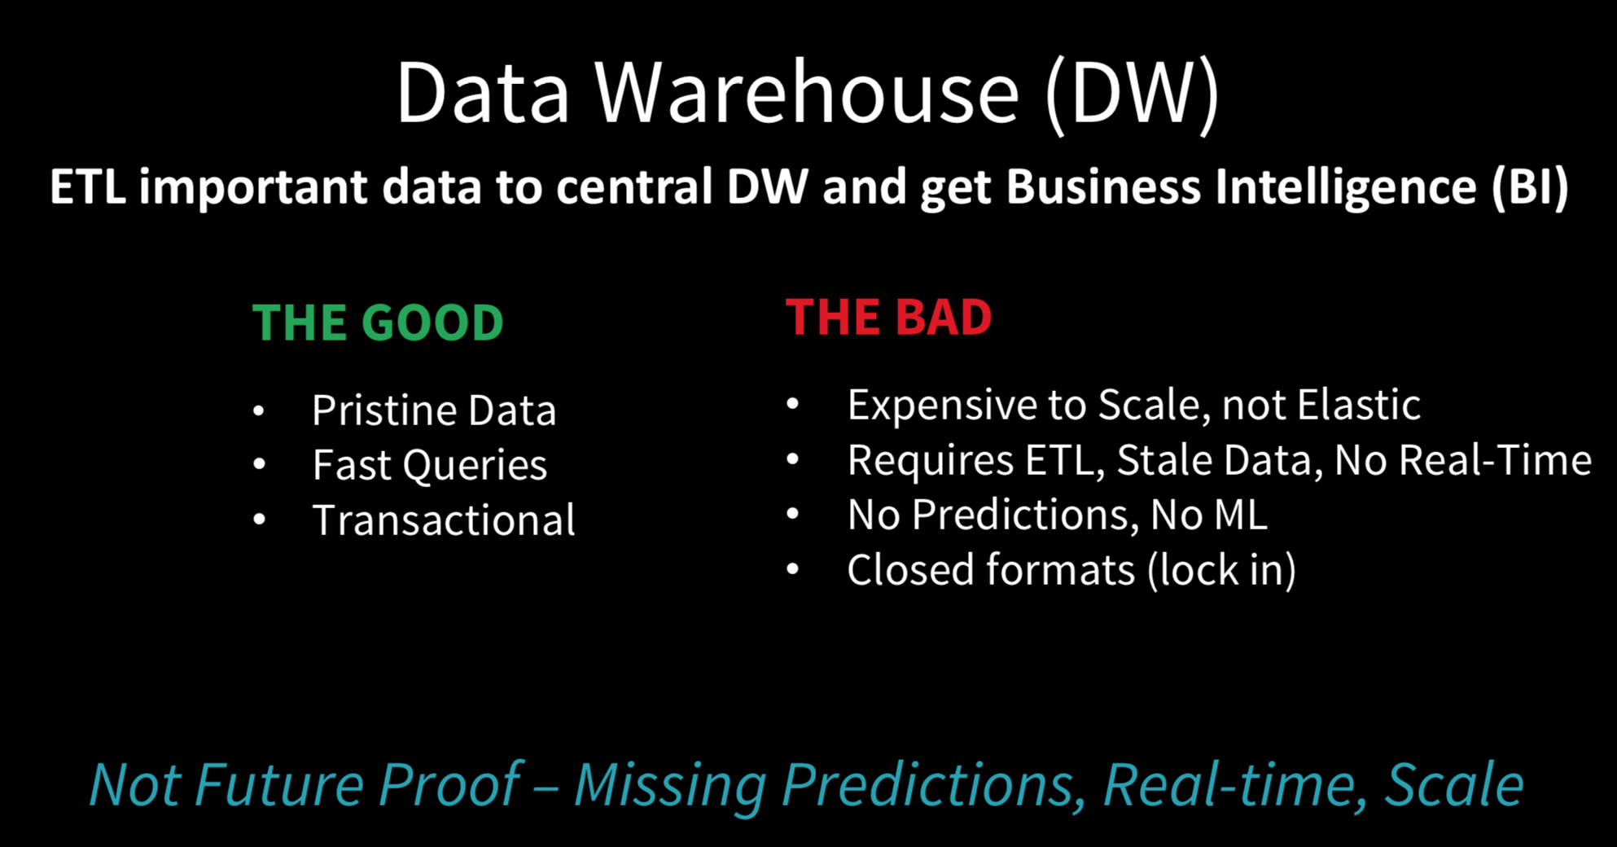

Slide 23
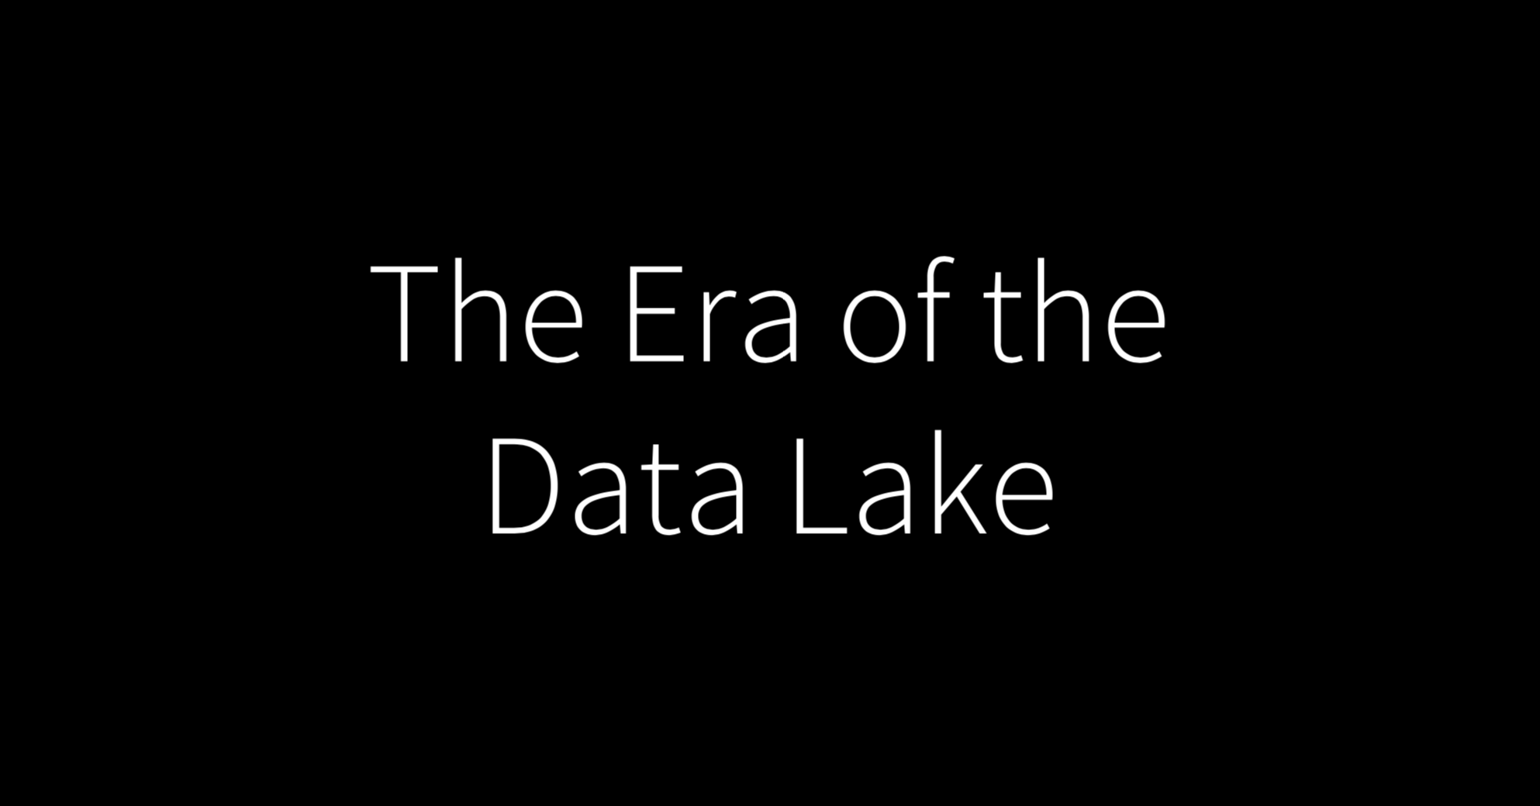

Slide 24
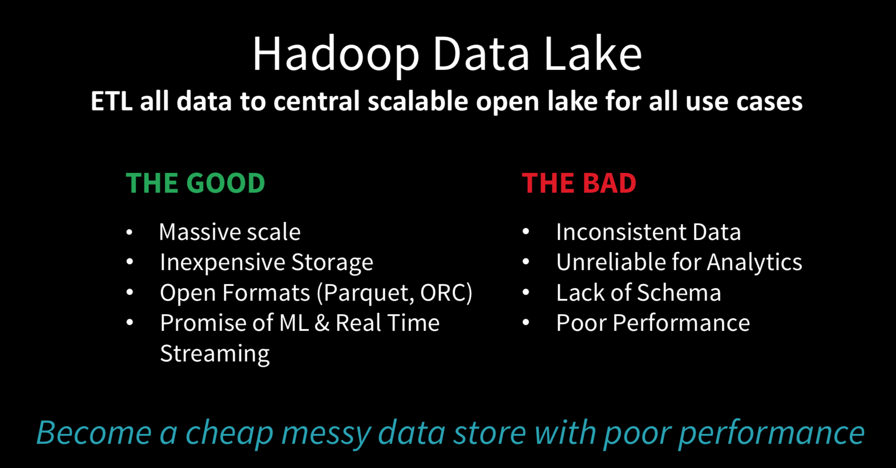

Slide 25
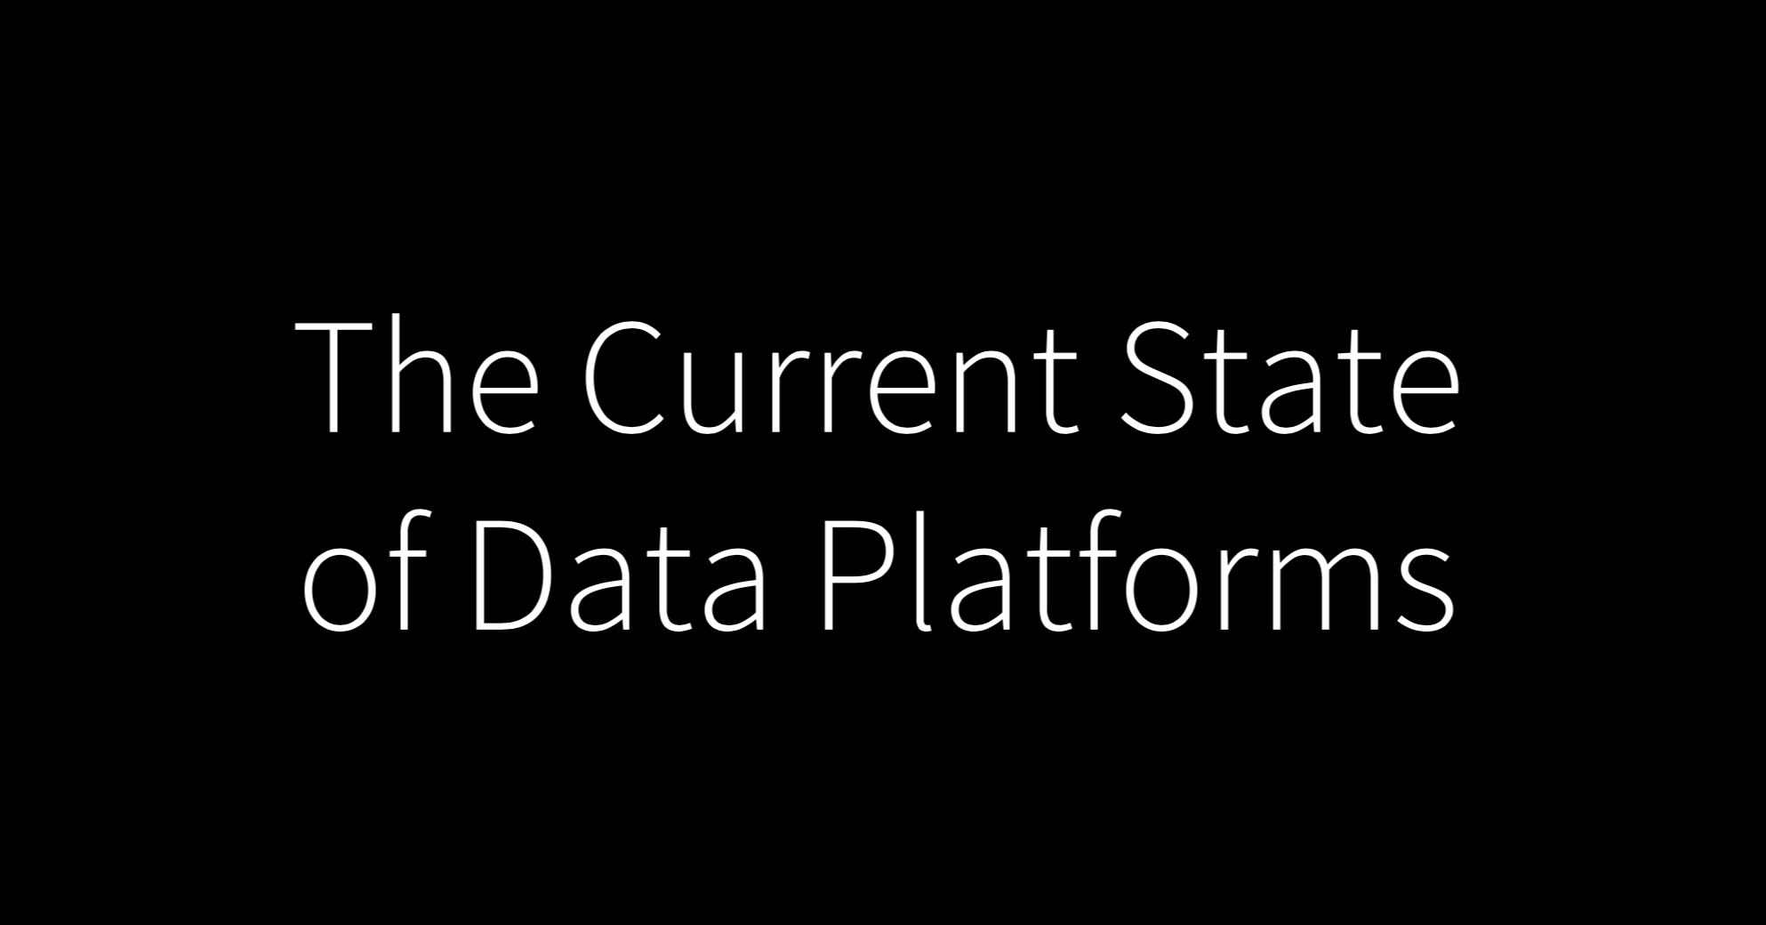

Slide 26
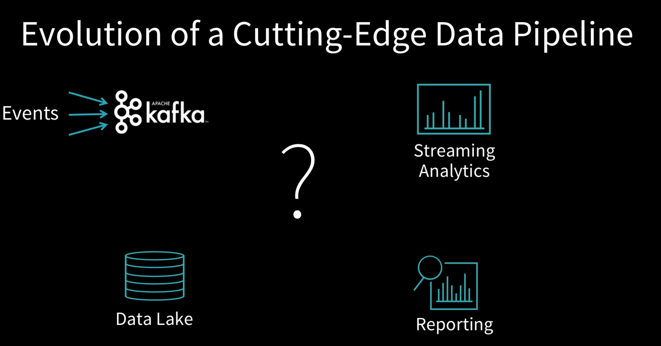

Slide 27
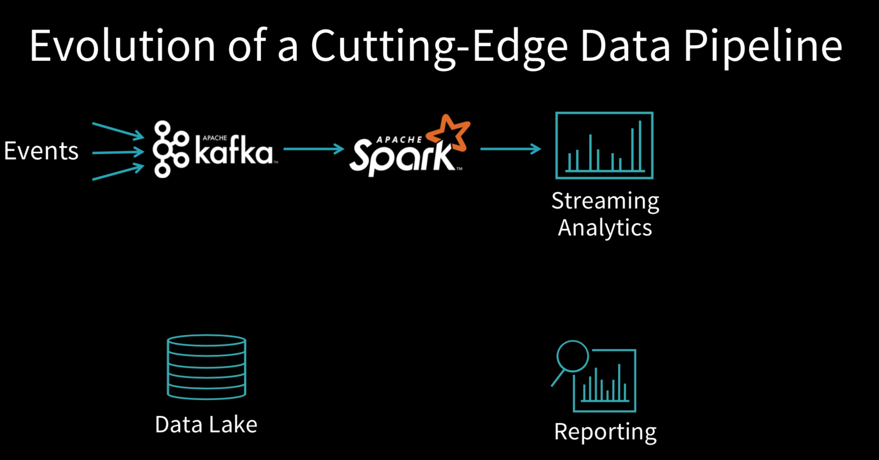

Slide 28
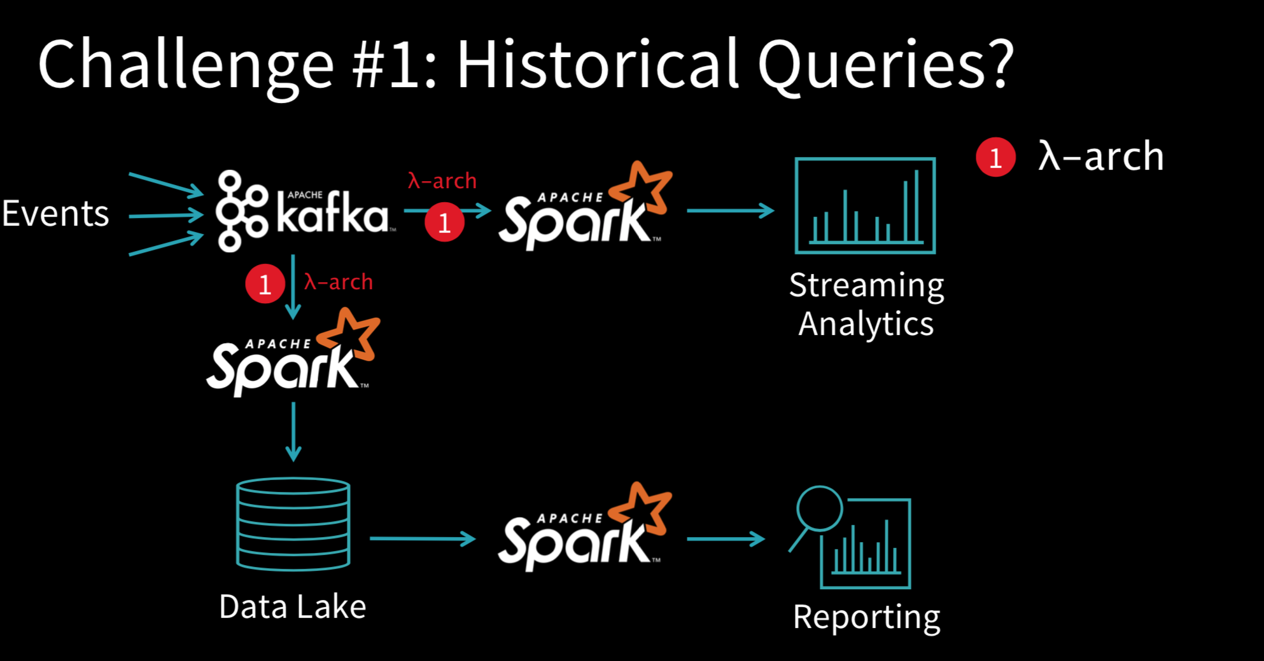

Slide 29
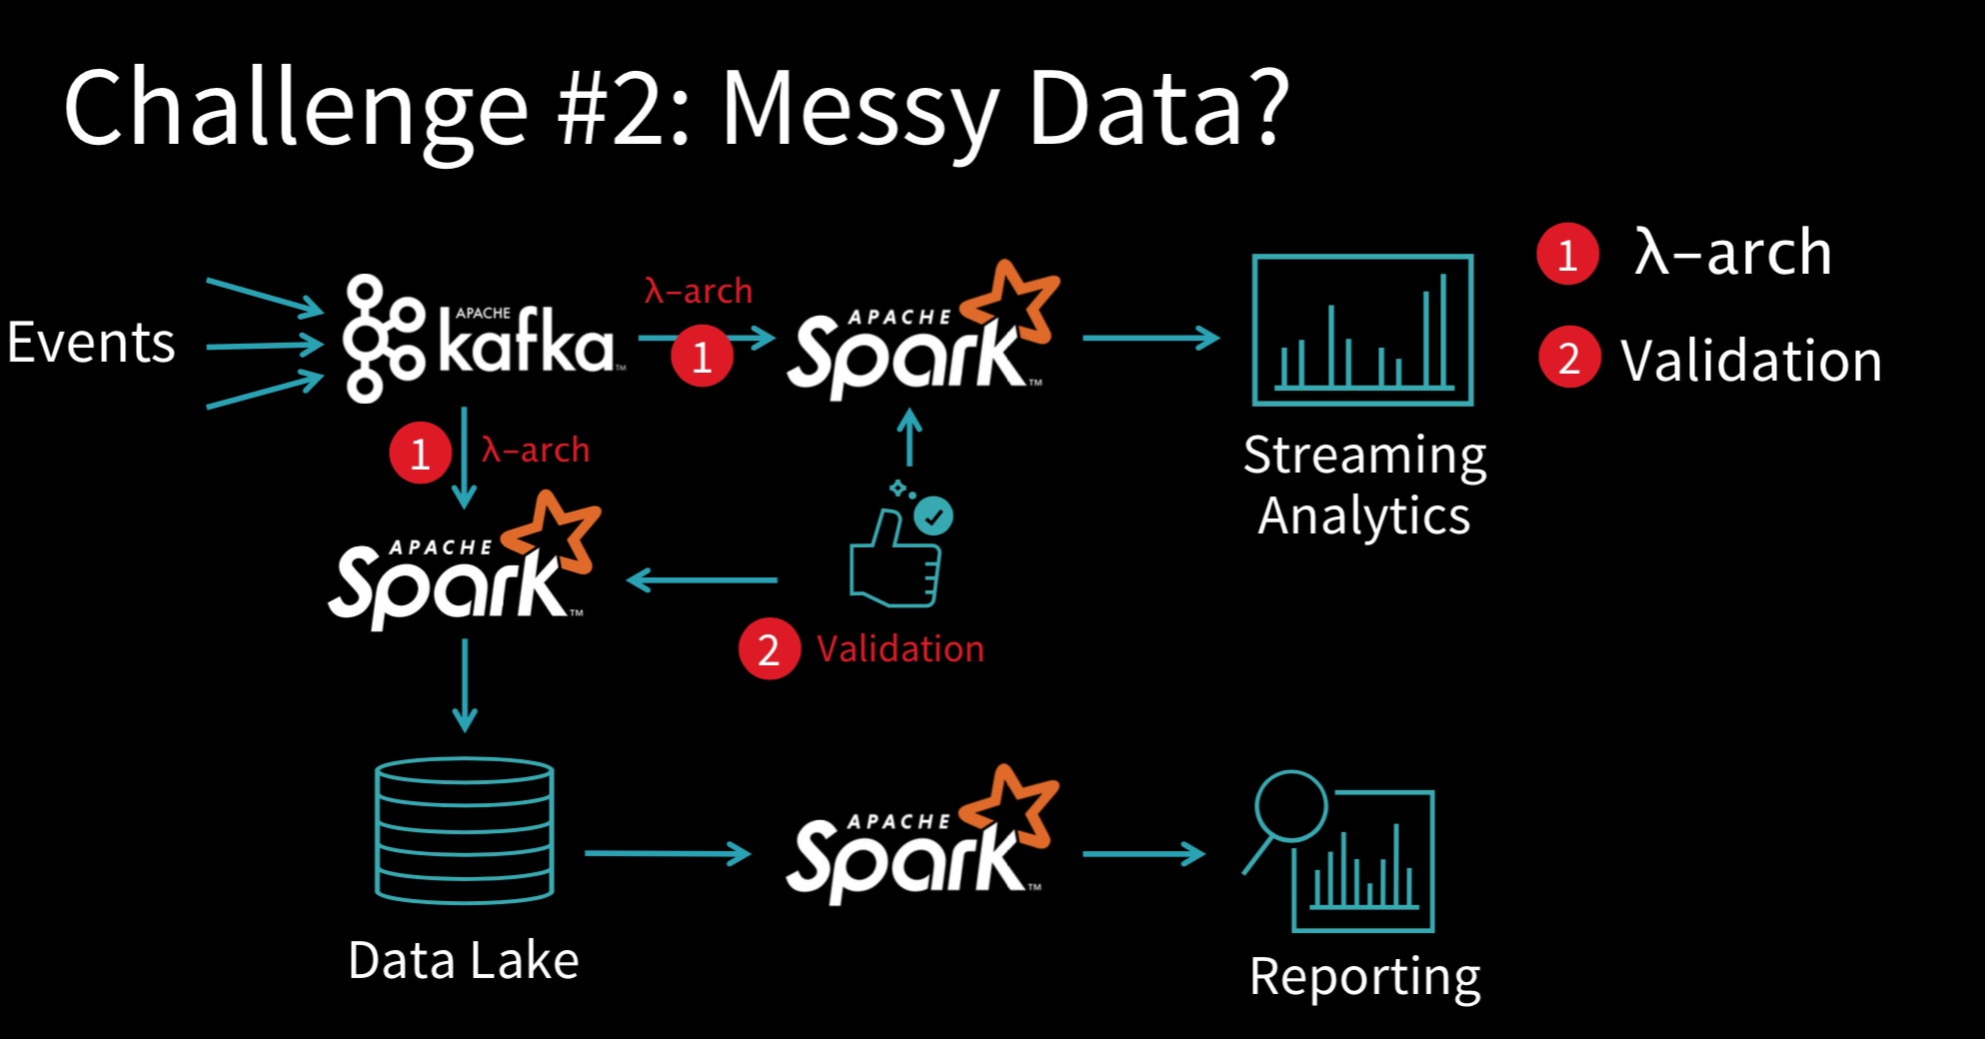

Slide 30
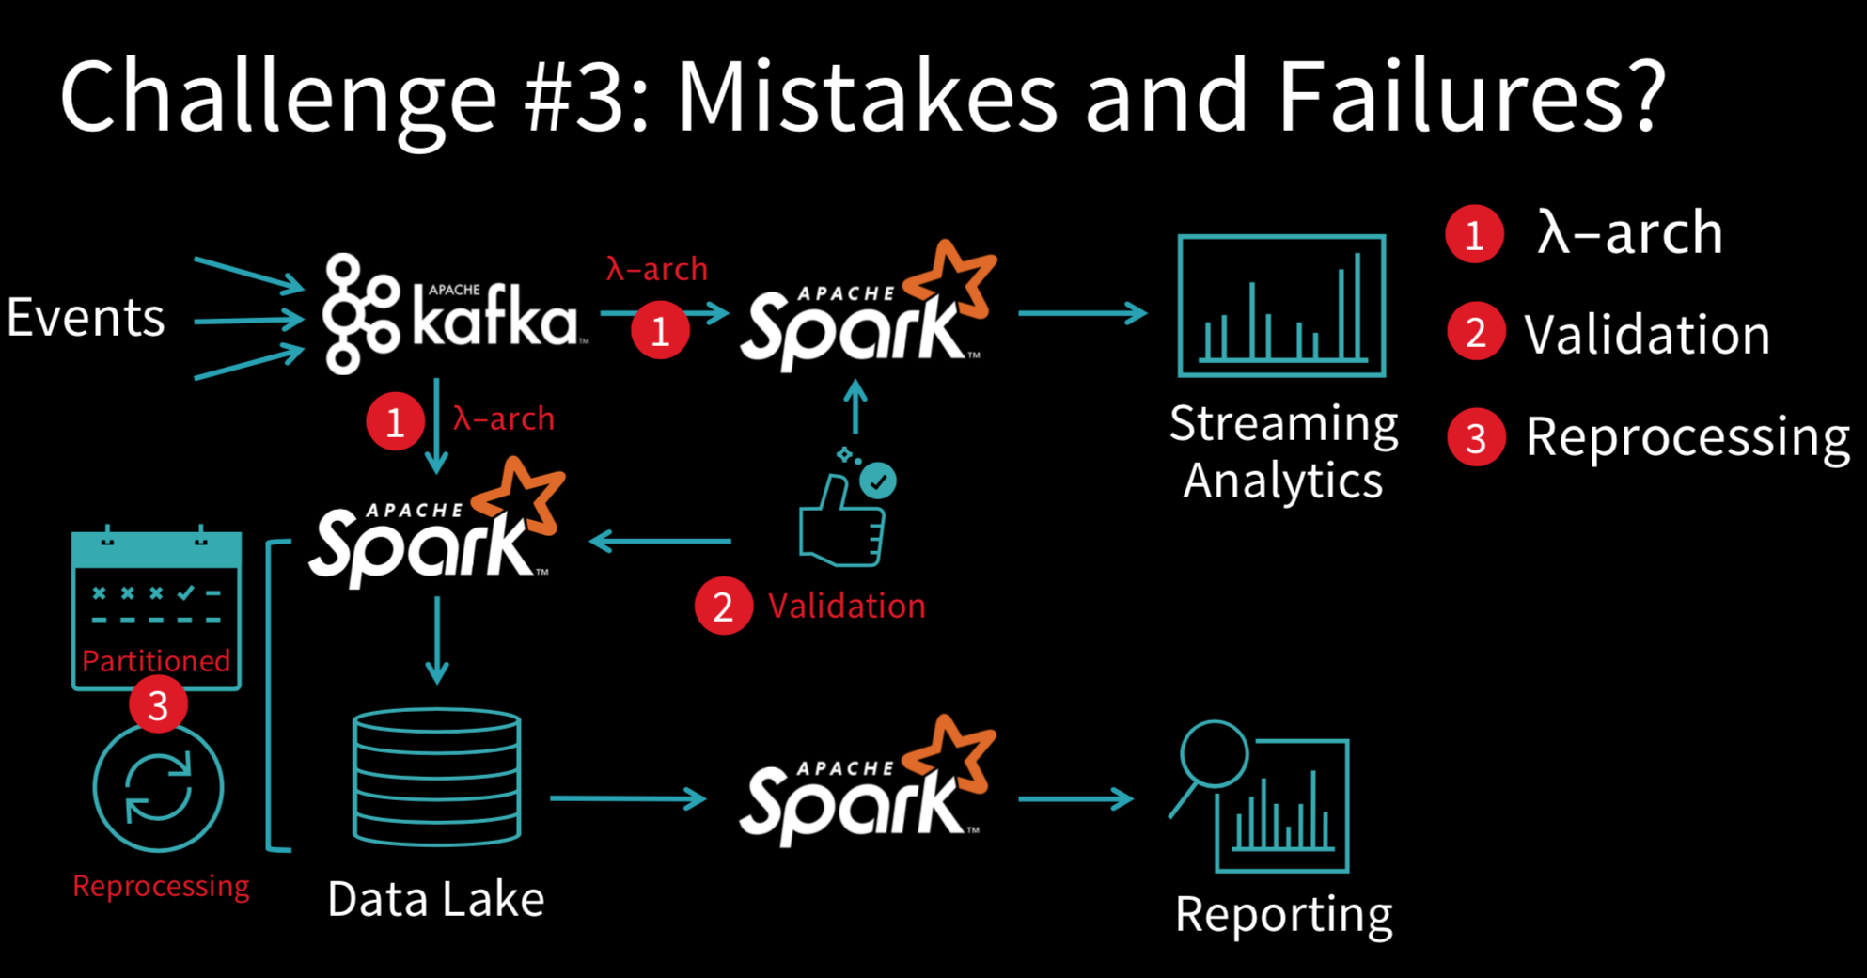

Slide 31
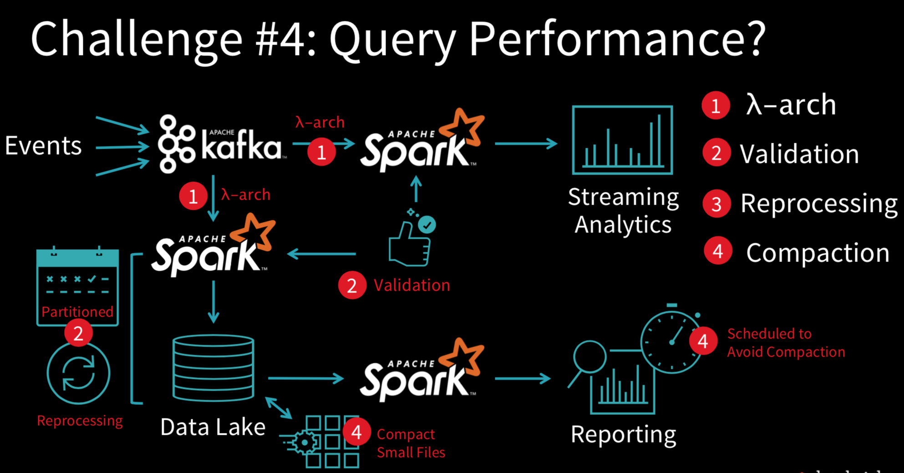

Slide 32
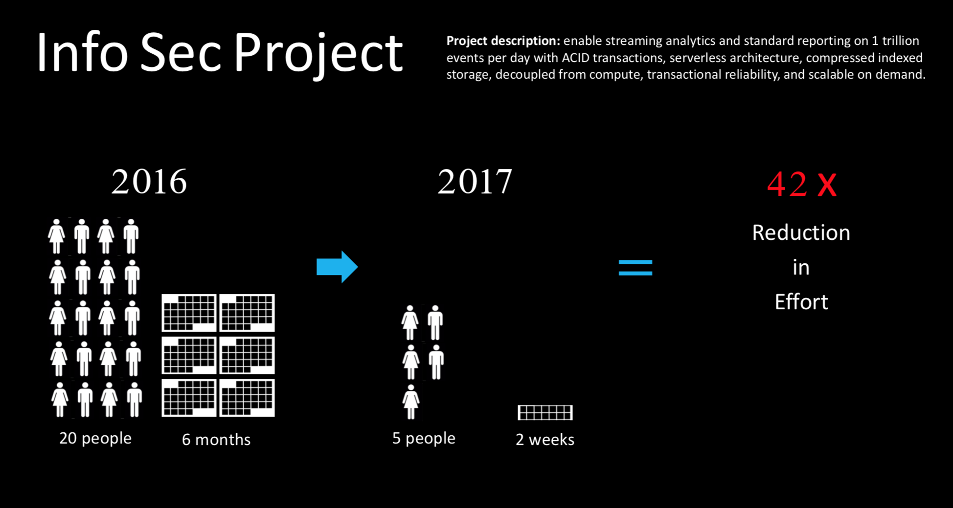

Slide 33
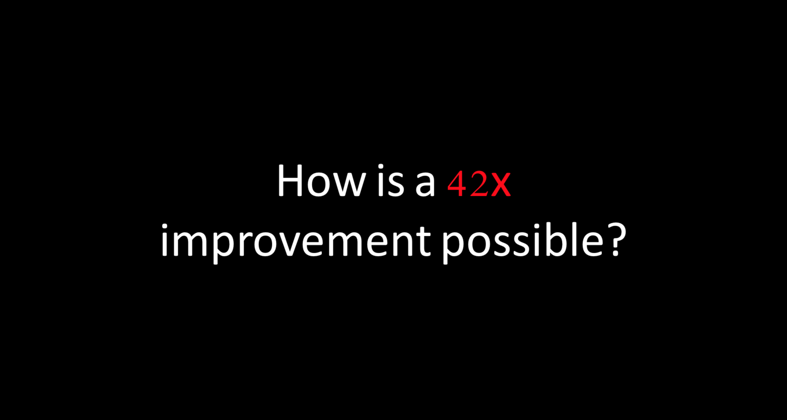

Slide 34
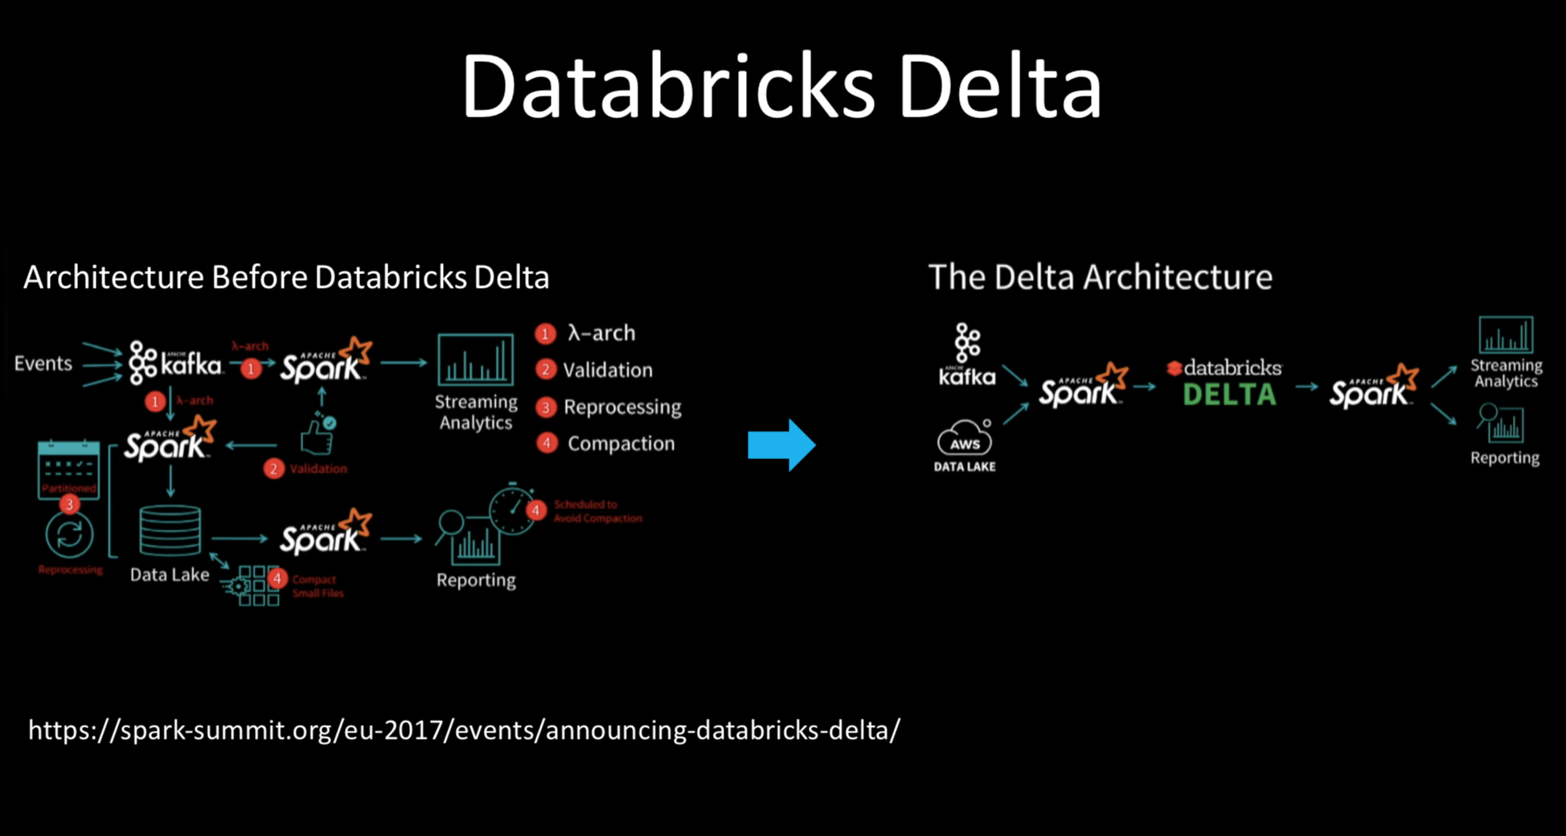

Slide 35
